Slide 1
Secure Data Hiding in Images Using Steganography
CAPSTONE PROJECT
Presented By: C Sree Sankar
Student Name : C Sree Sankar
College Name & Department : College of Engineering Perumon
Computer Science and Engineering

Slide 2
OUTLINE
Problem Statement
Technology used
Wow factor
End users
Result
Conclusion
Git-hub Link
Future scope

Slide 3
Problem Statement
The primary difficulty in image-based steganography is to develop a system that safely conceals data within digital images without disturbing the visual integrity of the image and making the concealed data resistant to attacks, including compression, noise attacks, and forensic inspection.
This includes optimizing the trade-off between data capacity, image quality, and security to avoid detection and ensure that the concealed information can only be extracted by legitimate users.
This work is intended to create a secure, effective, and adaptive steganographic method that can resist a wide range of attacks and be implemented in practical applications, including secure communication, watermarking, and privacy protection of digital media.

Slide 4
Technology used
1. cv2 (OpenCV)
Purpose: Used for image processing tasks such as reading, manipulating, and saving images. In the code, it is used for loading the image (cv2.imread()) and saving the modified image (cv2.imwrite()).
2. os
Purpose: Provides a way of interacting with the operating system. In the code, it is used to open the encrypted image file after it is created (os.system(f"start {encrypted_img_path}")), which opens the image using the default image viewer.
3. tkinter
Purpose: Used for creating the graphical user interface (GUI). It provides tools for creating windows, labels, buttons, text fields, etc. In the code, it is used to create the user interface for loading an image, entering a secret message, entering a passcode, and performing encryption and decryption actions.

Slide 5
Wow factors
LSB-Based Steganography : Hides data in the Least Significant Bit, ensuring security without visible image changes.
Lossless BMP Processing : Works with uncompressed BMP images to maintain data integrity.
Easy to Understand & Fast : Written in python making it easy to understand and reliably fast.
Simple CLI Interface : Easy command-line usage for embedding and extracting data, ideal for automation.

Slide 6
End users
Cybersecurity Professionals : Use steganography for secure data transmission and covert communication.
Forensic Experts : Extract hidden information from images for digital investigations.
Government & Defence Agencies : Securely embed sensitive data in images for intelligence and confidential operations.
Researchers & Academics : Study and improve steganographic techniques for data security and cryptography.
Privacy-Conscious Users : Individuals who want to protect personal or confidential information from unauthorized access.

Slide 7
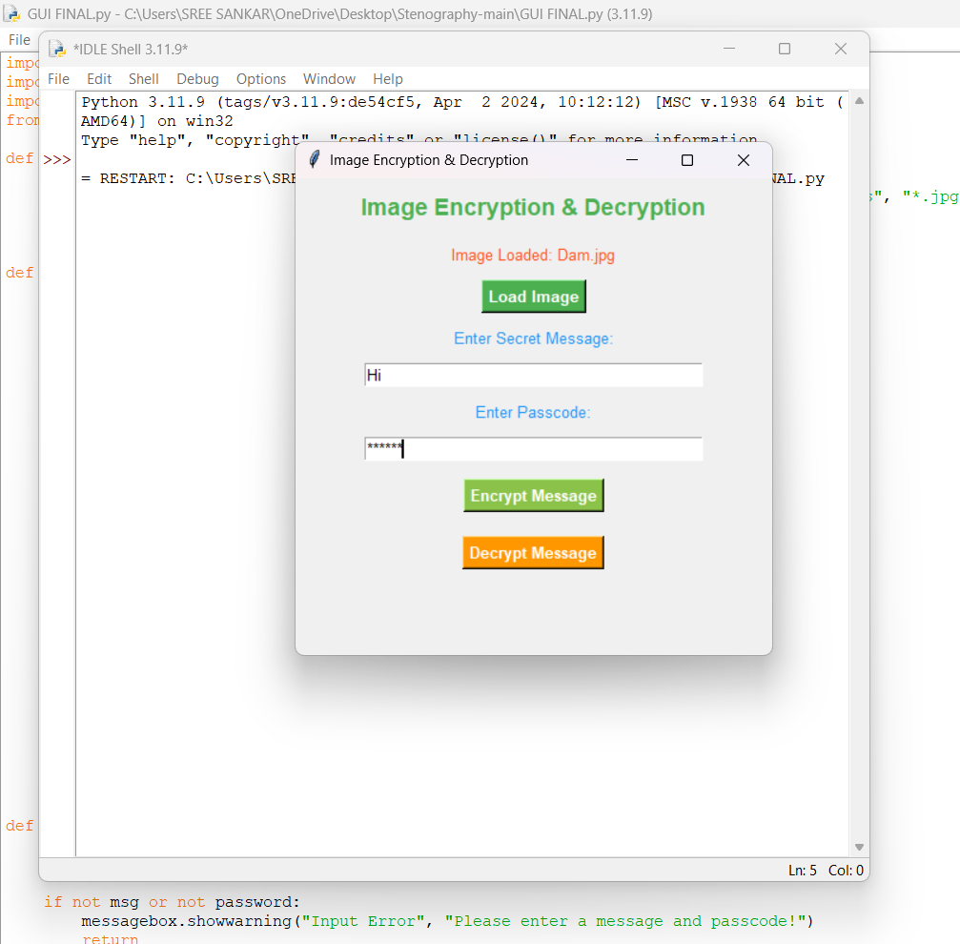
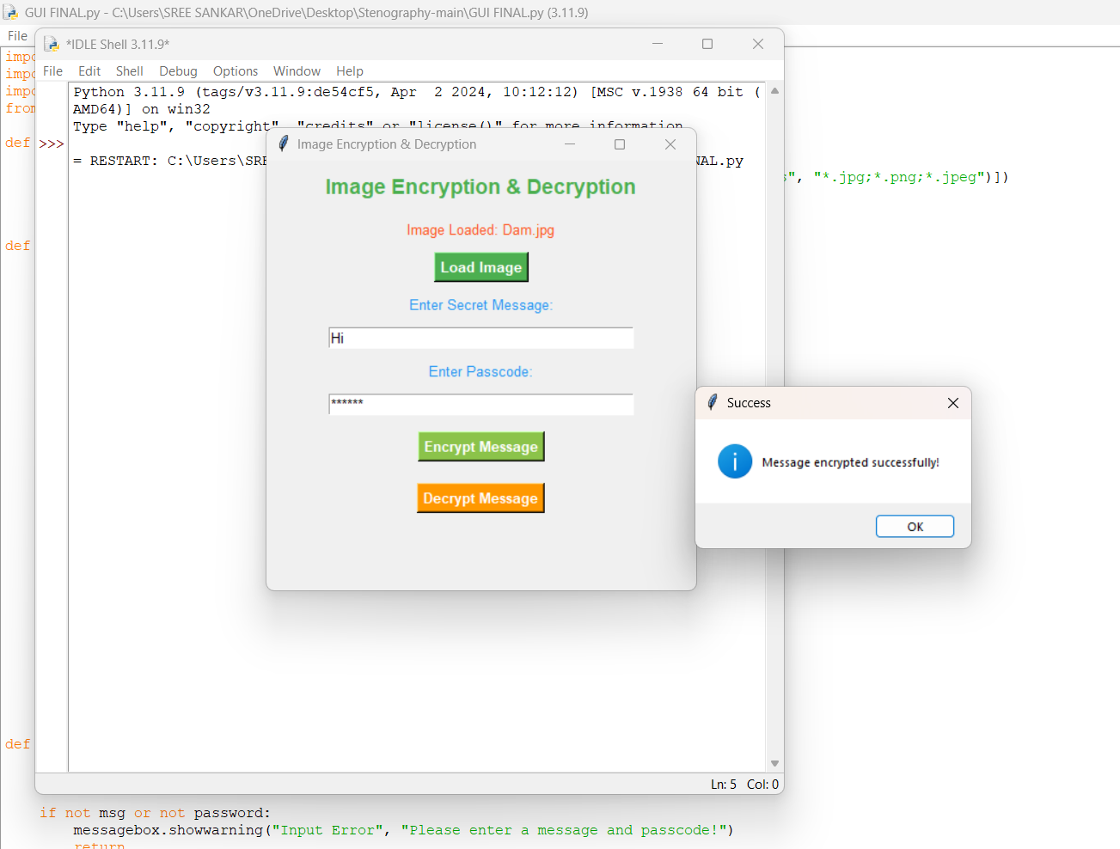
Results

Slide 8
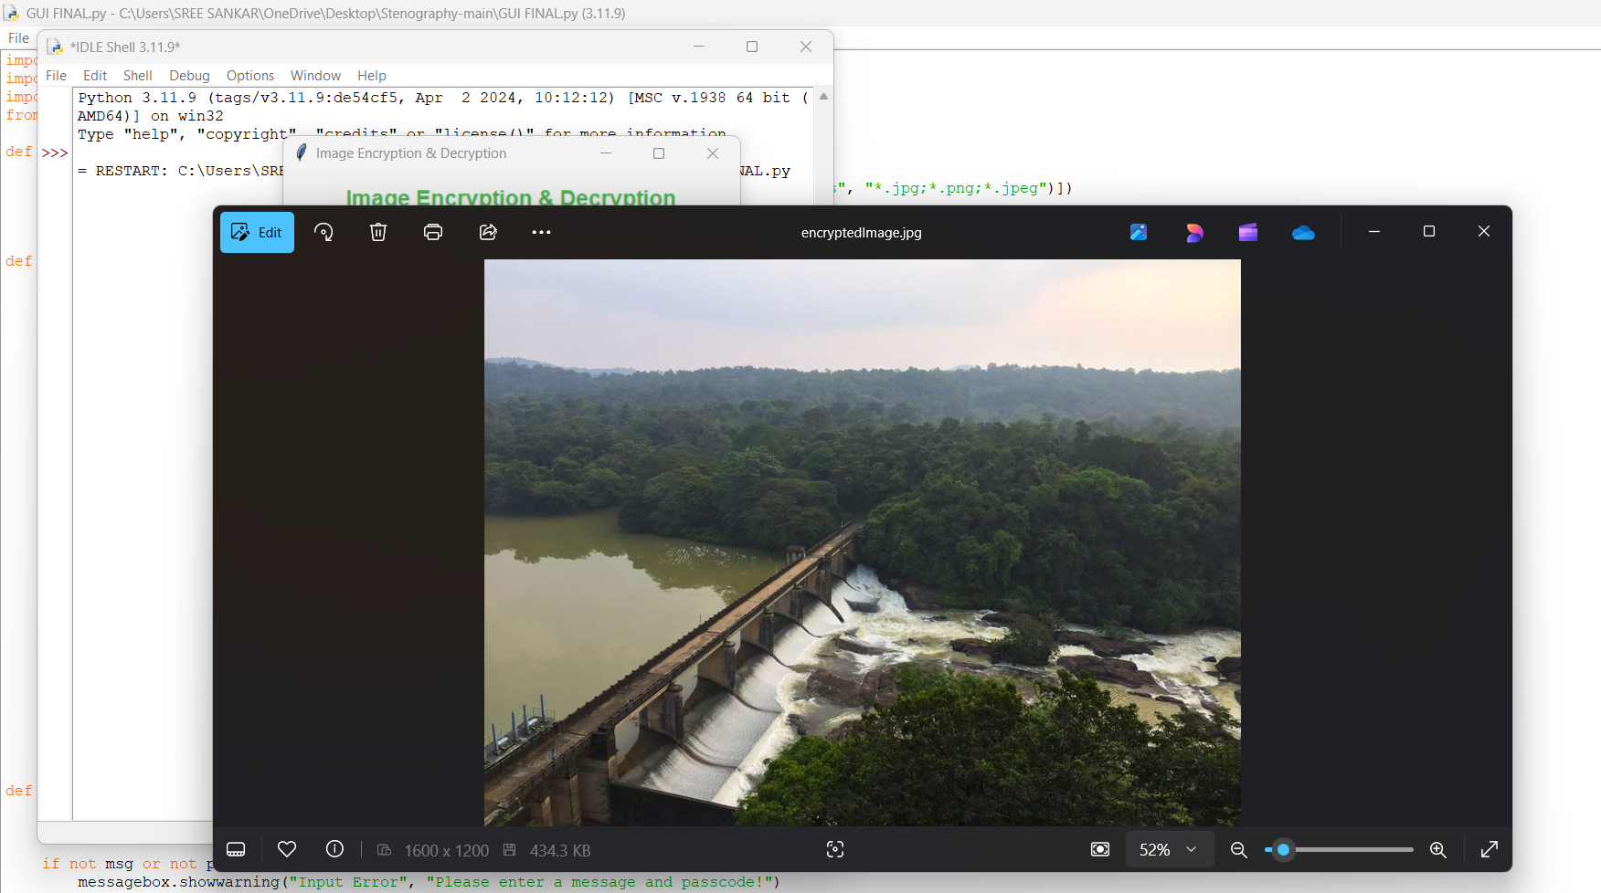
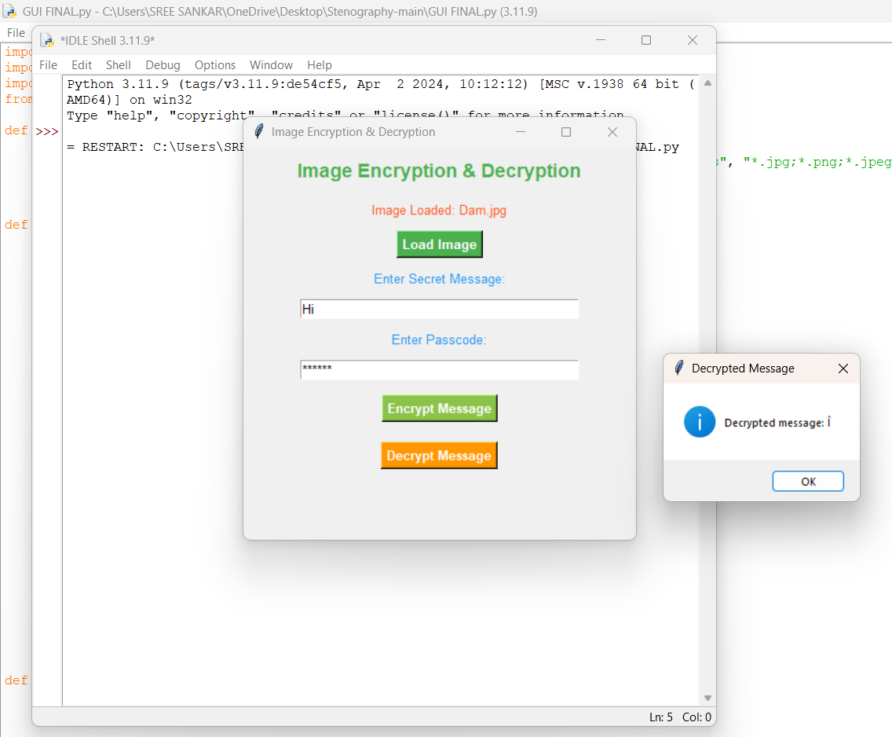
Results

Slide 9
Conclusion
This project successfully addresses the challenge of securely hiding data within an image using LSB-based steganography. By modifying the Least Significant Bit (LSB) of pixel values in BMP images, it ensures that sensitive information remains hidden without noticeable visual changes. The approach maintains data integrity, works efficiently with minimal dependencies, and provides a simple CLI interface for embedding and extracting data.
While the current implementation supports BMP files, it can be extended to support other formats like PNG or use DCT-based methods for JPEG. This project provides a lightweight, fast, and secure solution for data confidentiality, making it useful for cybersecurity, forensics, and private communication.

Slide 10
GitHub Link
https://github.com/SreeSankar17/SteganographySreeSankar.git
The link contains:
Source Code : A python program for embedding and extracting hidden messages.
Resulting Encrypted Image
PPT link of the project

Slide 11
Future scope(optional)
Drag and Drop Support : Allow users to select images and messages through a simple drag-and-drop interface.
Customization Options : Provide settings for users to adjust the encoding method and choose different bit depths.
Real-time Preview : Show a preview of the image before and after steganography is applied.

Slide 12
THANK YOU

